Slide 1
✦Jude Force
Technical PPT
Prism AI
Privacy-first, offline-capable multi-format content generation — guarded input, RAG-grounded local LLM + LoRA generation, and audited export. Fast generation
Team Jude Force · Prince Dr K Vasudevan College of Engineering and Technology
Qwen2.5-7B-Instruct + LoRA
Qdrant RAG
FastAPI + Celery
100% Offline Inference
Guardrailed Output

Slide 2
ARCHITECTURE
Tech Stack
Frontend | React, Vite, react-dropzone, react-query
Backend | FastAPI, Uvicorn, Celery, Redis broker
AI / LLM | Qwen2.5-7B-Instruct + custom LoRA adapter (local GPU / vLLM)
Parsing | PyMuPDF (PDF), python-docx, pytesseract (OCR), faster-whisper (A/V)
Embeddings | sentence-transformers — BAAI/bge-m3
Vector DB | Qdrant — chunk storage & retrieval
Database | PostgreSQL — User, Job, SourceContent, GeneratedArtefact
Object Storage | MinIO — S3-compatible, presigned download URLs
Guardrails | detoxify, rapidfuzz, presidio-analyzer, hashlib (SHA-256)
Export | reportlab (PDF), python-docx, python-pptx

Slide 3
END-TO-END FLOW
Pipeline — Source to Verified Artefact
0
Setup Docker Compose brings up Qdrant, Postgres, MinIO, Redis for the whole team
1
Core Skeleton FastAPI + models + Celery wired; file lands in MinIO, job created
2
Multimodal Input + RAG Parse PDF/DOCX/image/audio → chunk → embed → Qdrant
3
Input Guardrails File validation, PII redaction (presidio), prompt-injection scan
4
LLM + LoRA Generation RAG-grounded prompt → Qwen2.5-7B + LoRA, local GPU
5
Output Guardrails Grounding, toxicity, plagiarism, format checks
6
Export PDF / DOCX / PPTX rendered, SHA-256 hashed, uploaded to MinIO

Slide 4
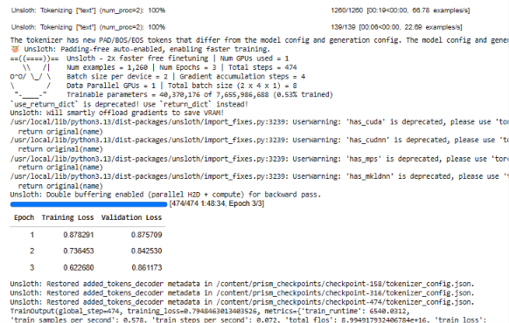
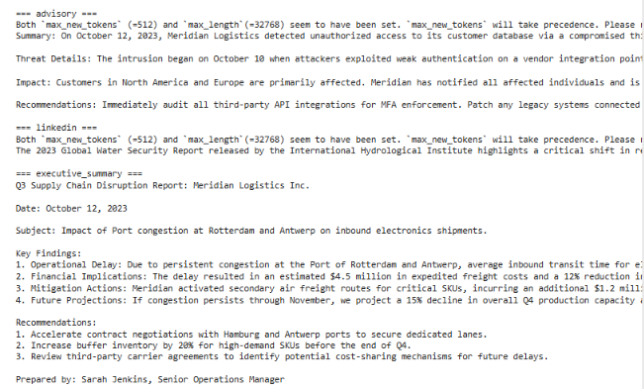
PHASE 4 · PROVEN ON REAL HARDWARE
LLM + LoRA Generation
Qwen2.5-7B-Instruct fine-tuned via QLoRA on synthetic per-format training pairs (150–300 each, generated with Groq API), trained on Google Colab GPU, then run fully offline for inference on a local RTX 3050.
📎 Google Colab training screenshot
Priority formats: Advisory · LinkedIn Post · Executive Summary
vLLM multi-LoRA adapter hot-swapping

Slide 5
PHASE 5
Output Guardrails
Checks
Job Outcome Logic
Grounding: factual/number overlap with source chunks, fails below 0.6
Toxicity: Detoxify neural model, flags above 0.5
Plagiarism: RapidFuzz ratio, flags near-verbatim overlap above 0.85
Format: per-format schema (LinkedIn ≤ 3000 chars, advisory needs headers)
Blocking: grounding or toxicity failure on any artefact → job status “failed”, with the specific check named
Non-blocking: plagiarism / format failures stored as warnings, job still “completed”
Integrity: SHA-256 hash stored per artefact for tamper-evidence

Slide 6
WHY IT MATTERS
Fully Offline After Setup
Docker images (Qdrant, Postgres, MinIO, Redis) | Once, first pull only
AI model weights (Qwen2.5-7B) | Once, initial download
Generation, vector search, storage, DB | Never — all self-hosted / local
Frontend ↔ backend | Never — both on localhost
Demo video: disconnect Wi-Fi entirely after setup, then run the full pipeline live recording.
https://drive.google.com/drive/folders/1kVAlRx1roWhoYzQcKOEtgam5LHUy_XVs?usp=sharing

